Slide 1
The New Data Management Landscape in Higher Education
Licensed under CC BY-SA 4.0 by DXtera Institute - 2020
Notes:
JEFF:

Slide 2
Before we Begin….
This webinar will be recorded.
All attendees will be on mute.
There will be a Q&A period at the end. Please use the Q&A or Chat features for queuing up questions.
We will be sending out a post webinar email that will include a link to the recording.
Notes:
JEFF:

Slide 3
DXtera Institute - Priority Areas
Next Generation Education Systems
Data Management Solutions
Integration Solutions
Notes:
JEFF:

Slide 4
Value of Membership with DXtera
Invest in a reusable, scalable DXtera solutions to optimize data exchange
Membership provides access to all open and consortium-sourced solutions, network of experts, products and education
Engage with the growing community to change the market
Notes:
JEFF:

Slide 5
Today’s Presenters
Charles Ansell, COO, Community College System of New Hampshire
Matt Gee, CEO, BrightHive
Amon Horne, Deputy CTO & Dir. of Strategic Initiatives, DXtera Institute
Scott Thorne, Senior Architect, DXtera Institute
Mary Weisse, Product Owner - Data Warehouse, DXtera Institute
Notes:
JEFF:

Slide 6
Overview
Notes:
AMON: This work is the result of multiple DXtera projects, the primary one being a literature review of various Data Usage and Management studies, analysis and surveys across various media going back to 2012 including (Educause, Gardner, Stanford Work, MIT, etc.)

Slide 7
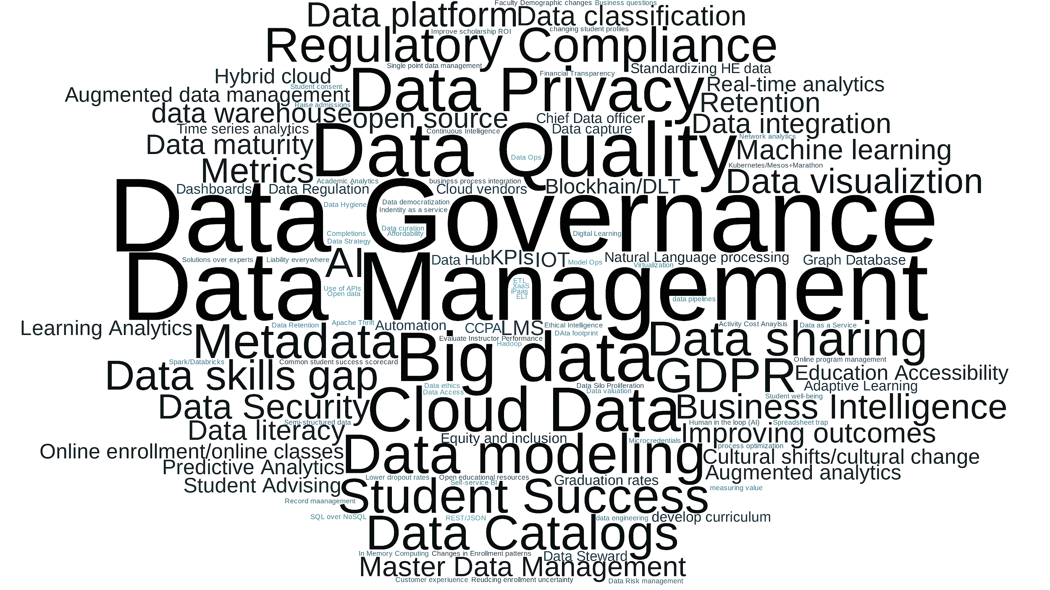
Trends Part 1
Notes:
AMON: We see some general data usage and management trends across both Higher Education and in general usage:
Increased desire for data
Frustration around data access
Desire to use AI/automation to streamline processes
Data resource issues
Increase concerns around security
A desire to move to more data-driven organization
Responsible data use and others

Slide 8
Trends Part 2
Data proliferation
Data integration
Data Warehouse
LMS
Cloud vendors
Data capture
Data Hub
Graph Database
Data as a Service
Data democratization
Data Silo Proliferation
ELT
Hadoop
REST/JSON
Semi-structured data
Use of APIs
Good Data Practice
Data Analysis/Analytics
Data Governance
Data Management
Data Quality
Business Intelligence
Data Maturity
Data Privacy
Data Modeling
Data Catalogs
Data Sharing
GDPR
Metadata
Regulatory Compliance
Data skills gap
Data platform
Data Security
Responsible Use of Institutional Data
Data-driven/informed decision making
Improving outcomes
Cultural shifts/cultural change
Education Accessibility
Learning Analytics
Online enrollment/online classes
Predictive Analytics
Student Advising
Adaptive Learning
Faculty Demographic changes
Develop curriculum
Equity and inclusion
Graduation rates
Natural Language processing
Academic Analytics
Data ethics
Notes:
AMON: In focusing purely on data usage and data management we can roll this up into 3 primary areas :
Data proliferation + Users need the right data to do their job
Data Stewardship: What is good data practice/responsible use of student data

Slide 9
Data Usage Maturity Model
Un-managed
Isolated
Unified
Managed
Analytic
Technology
Spreadsheets
Data Set tools
Data Warehouse
Self-Service
Data Definitions
Data Catalog
Role-Based Access
Analytics/ML Toolkits
Manually compiled, non-standard reports
Some reports development, but no unified data platform
Standardized Data Reporting
Initial Metrics/KPIs
Automated DQ
Data-driven decision making
Descriptive Analytics. Automated DQ
Forecasting and planning. Predictive Analytics
Data Usage
Ad hoc, incomplete and inconsistent
Local definitions, local management
Access control still ad-hoc
Common data store & definitions. Active data quality and metadata management
Process-driven data access, quality and performance management
Integration of automated quality, profile and access tools
Data Management
Biggest Hurdles
Data acquisition
Data preparation
Data Management
Data Quality
Shared data vision
Data Governance
Tool development
Data Security
Key Users
No user class
Analysts
Everyday Users
Data Stewards
Tool Builders
Notes:
AMON: The issues and opportunities that we see in the last two slides have a fundamental core issue in the higher education space: A lack of data management, governance and usage maturity
This diagram outlines the process, and impacts of moving to a more mature data usage, governance, and management model.
All of the issues above can be seen as a lack of sophistication and maturity, and all of the associated opportunities involve systems, tools and technologies that at least claim to optimize, streamline, or bypass the path to maturity.

Slide 10
CCSNH: Charles Ansell, COO
Notes:
Amon pass to Charles

Slide 11
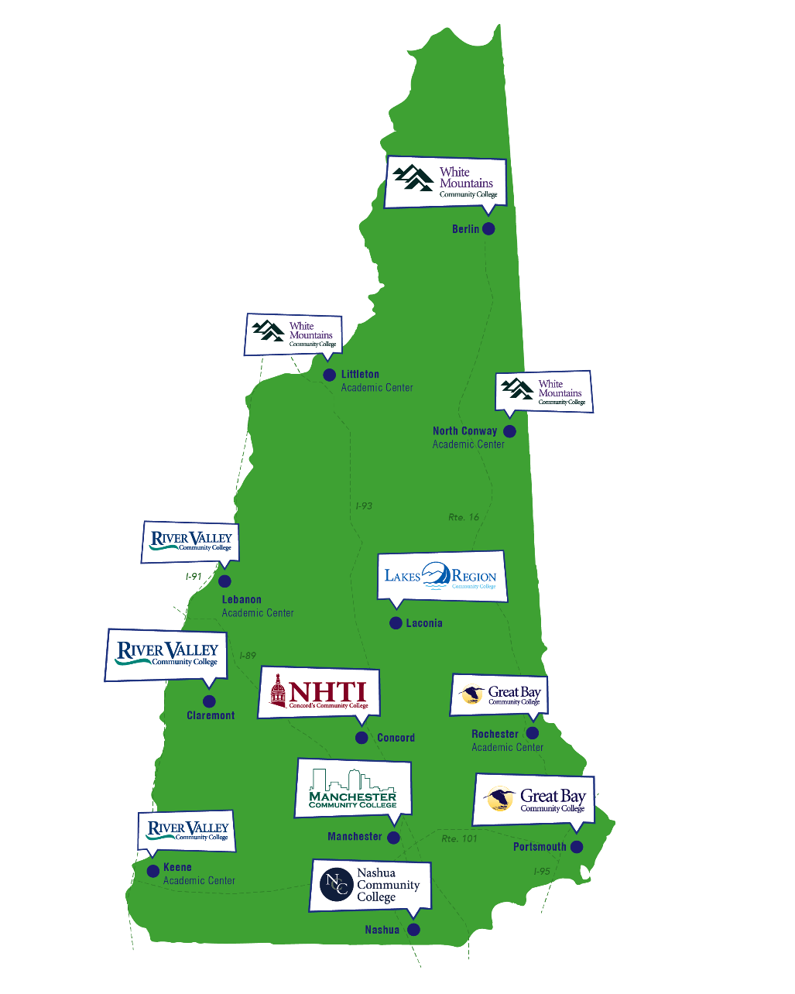
CCSNH’s mission centers on student success and access, aligning with workforce and educational attainment needs
CCSNH serves about 25,000 students annually, which translates to roughly two percent of the adult population of New Hampshire any given year is a CCSNH student, once you exclude dual-credit programming
For 2019-2020:
33% are 25 years old or older
49% of our students are part-time
Notes:
CHARLES

Slide 12
65 X 25 goals fall within our mission and influence our work
The Community College System of NH introduced 65 by 25, a goal to help ensure that 65 percent of adults 25 and older in New Hampshire will have some form of post-secondary education, from certificates to advanced degrees, by 2025. Achieving this goal moves New Hampshire much closer to targets cited in national research and positions New Hampshire to support a strong future economy, and we still plan to move towards this through and post-pandemic.
Failure to reach that goal will harm the state’s ability to retain, attract and grow business, and will have long-term effects on the state’s economy and quality of life.
Notes:
CHARLES

Slide 13
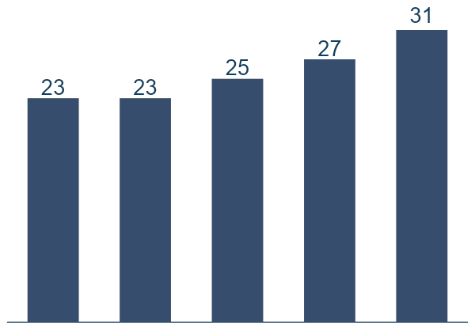
CCSNH leads the region in awards growth and other metrics
3-Year Grad Rate – Last Five Years
+34.8%
Record total graduate numbers
CCSNH has New-England-region leading graduation rates for the community college sector at various cohort levels, and expects current retention strategies to have a dramatic, continued positive effect on these outcomes
2015
2016
2017
2018
2019
Notes:
CHARLES

Slide 14
65 by 25 > Strategic Goals > Objectives > KPI’s
Assure pathways lead to academic and career success in NH
Maintain economic and transfer value of all CCSNH academic programs
KPIs: Median earnings, transfer post-completion
Continuously advance the vibrancy of teaching and learning, and of classroom experience, and support students on pathways relevant to meet academic goals
KPIs: Grad rates (FT / PT), total graduates, avg. credits earned, success in gatekeeper Math / English
Strategically meet enrollment needs for the state, including addressing the unique needs of our differing communities
Improve rates at which adult residents of NH advance in higher education
KPIs: Total enrollment, fall-to-fall retention, age 25+ enrollment
Improve rates at which HS’ers matriculate / stay in NH
KPIs: Total enrollment, fall-to-fall retention, Matriculation rates from NH HS’s
Notes:
CHARLES

Slide 15
CCSNH employs a three-pronged Student GPS strategy
CCSNH continues work to make sure enough students graduate with a valuable credential to meet 65 by 25 imperative
All programs must have economic and transfer value
This translates, in the classroom, to vibrancy in teaching and learning, on top of curriculum informed by 4-years and employers
Student GPS means helping students succeed by making plans that are
Relevant | Intentional and Structured | Pace to Completion
Purposeful choice Appropriate Math Faculty-authored pathways Understanding of what it takes to be successful in College | Meta-major-based academic pathway choice Prescribed semester-by-semester coursework Block scheduling Registrations on plan | Firm understanding of what “two-year” college actually means Acceleration for developmental education
b
c
a
Notes:
CHARLES

Slide 16
Principles and process of performance dialogs
Metrics
Dialogs
Description
Description
Long-term outcomes
Overview of outcomes / KPIs with less frequency
E.g., 65 by 25 metrics
Dialogs
Frequency depends on organizational level
E.g., Monthly CFO meeting.
Leading indicators
Overview of effectiveness and efficiency factors that influence outcomes
Operations
Identify actions to improve outcomes
E.g., Action Items
Notes:
CHARLES

Slide 17
Data pain points today limit data-driven decision-making
Where we are today
Data lives in disparate systems
Different data elements reported differently out of these siloes
Few people understand data, as well as how to access it, mostly using complicated commands in student information systems to access clunky CSV files
Cross-walking data across learning management, student information, career exploration, and advising systems is an arduous task, when possible at all
Where we want to be
Centrally stored data to provide just-in-time information for decision support purposes, enabling more agile and intelligent student interventions
Data solution that evolves as our technology portfolio – and the broader higher education data technology landscape – evolves
Data warehouse within a broader interoperability framework for quickly connecting existing and new systems
Inexpensive data exchange that does not sacrifice quality
Ability to run cutting-edge, real-time analyses to help at-risk students
Joint platform with our partners
Notes:
CHARLES

Slide 18
Where we will be with DXtera implementation
Enables dashboard reporting from myriad tools, including Tableau, Rapid Insight, and Excel
By bringing together all student-facing systems, can allow for real-time analyses to unearth risk factors and spark rapid student interventions
New systems needs plug-in through connector-based interoperability framework
Data stability and speed through star-schema-based warehouse design
Ability to federate with external systems
FUTURE NEEDS
PARTNER SYSTEMS
CONNECTORS
Notes:
CHARLES

Slide 19
Performance management enables student success efforts
Professional development focuses on culture change
Higher reliance on technology, and thus better access to data, in a COVID-19 world
Virtual symposium, summits and other gatherings to promote data-driven decision-making from existing systems, informing solid project planning
Cross-institution events to promote idea and data exchange
Metrics and Evidence
Bolstered by Technology
Using metrics, informed by internal discussion and external agencies, to baseline student success and improve outcomes
Academic-focus-area-based structural changes follow enrollment, success, movement between/per meta-major
Measure intervention effects at precise levels, across systems
Enabling technologies for career assessments to inform academic choices
Data tools bring together disparate systems for ongoing decision support
Notes:
CHARLES

Slide 20
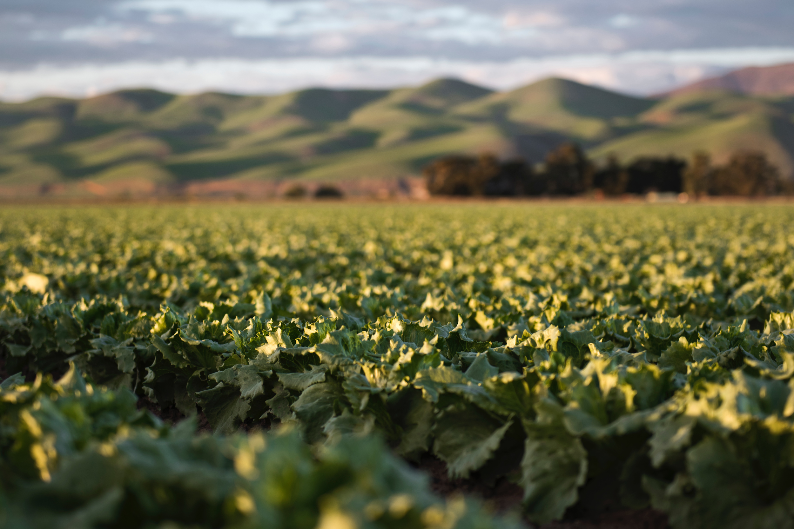
Farm to Table: Information Processing
How long does it take to harvest?
Where does this data come from?
What has been done to it?
What are all the ingredients (components) ?
Do you know the lineage of your data? Do you access to the same grouping/filtering that the creator did (can you unwind the grouping/filtering?
Notes:
SCOTT:

Slide 21
Farm to Table: Information Processing (cont)
Information should flow in a consistent and transparent process from validated systems of record to the end data consumer.
Data consumers should understand and confirm how information has been filtered, massaged, combined, and corrected along the way.
Information should be directly accessible by anyone who needs it to make decisions and do their job.
Delivering simple, reliable and easy to understand information to users is the best way to get more value from your institutional data
Notes:
SCOTT:

Slide 22
Topics
Trend 1: Data Proliferation and “The Wide Data Problem”
Trend 2: Data Stewardship: What is Good Data Practice
Trend 3: Responsible use of institutional data
Notes:
AMON:

Slide 23
Notes:
MATT

Slide 24
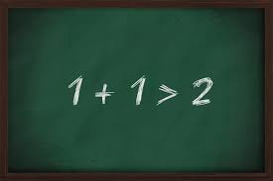
Unlike oil, data has combinatorial value
Notes:
MATT: One dataset plus one dataset

Slide 25
Aristotle Dreams of Data Integration
The whole data warehouse is greater than the sum of its parts.
Notes:
MATT: We’re getting aristotelian

Slide 26
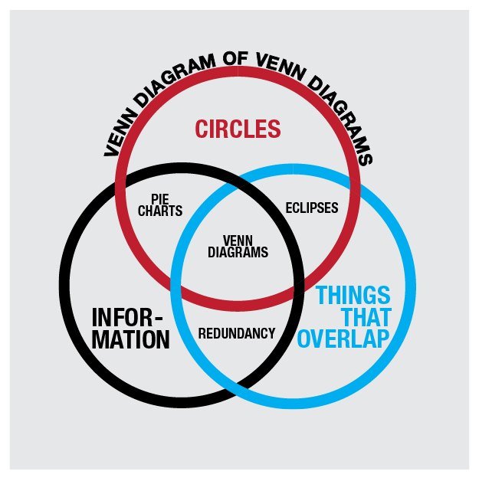
“The real impact of data always comes from the intersection of different data sets. You don't get into the earth shattering discoveries until you start to link disparate data sets… You can't look in isolation and find causes,"
--Dane Atkinson CEO sumall.org
Notes:
MATT: Data proliferation content does here

Slide 27
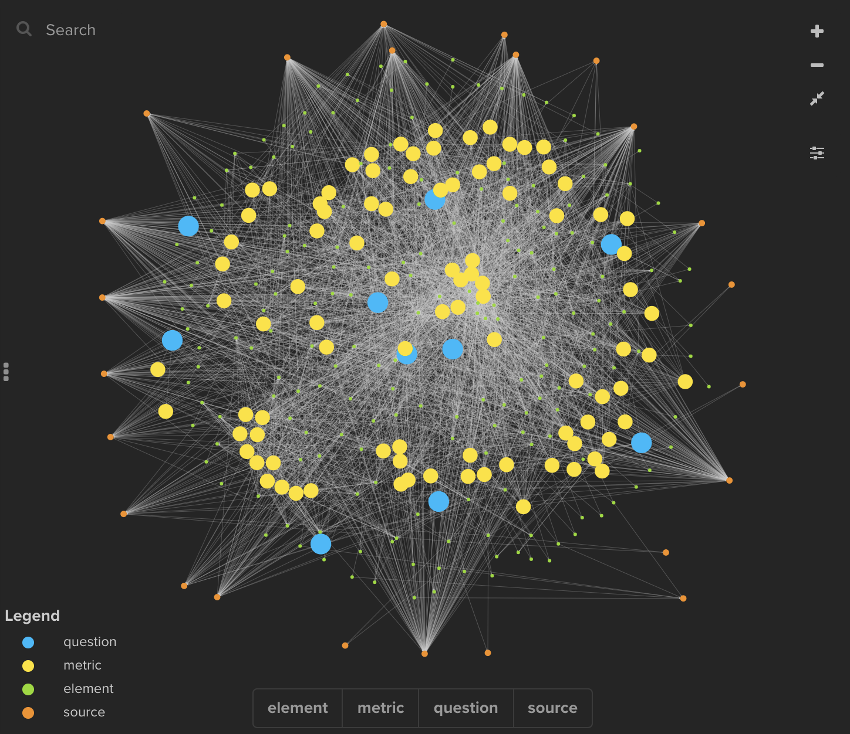
20 questions = 2500 data connections
Notes:
MATT: Question 1: Which credentials (degrees, certificates, microcredentials) are making a difference for underserved opportunity seekers in the workforce? By how much does postsecondary education exposure increase wages?

Slide 28
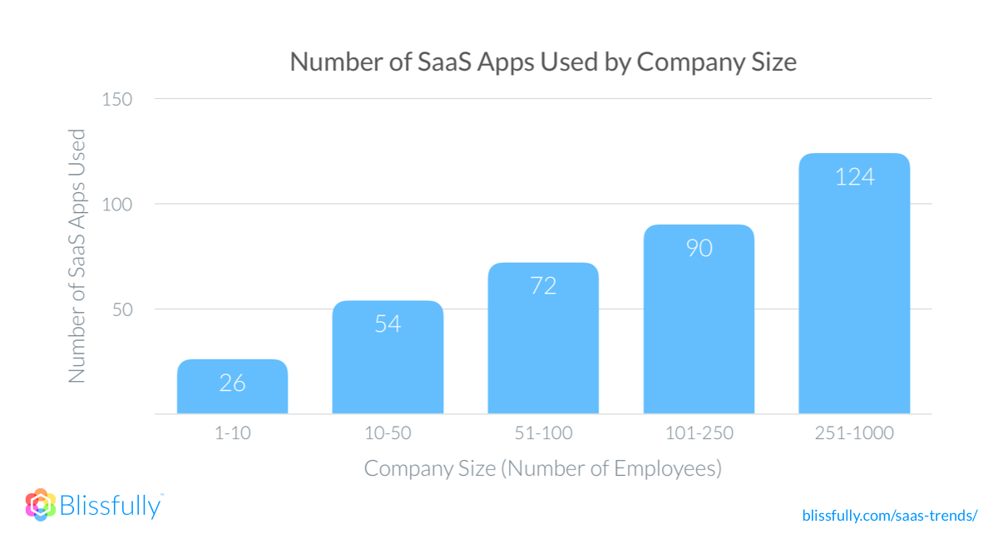
Number of data sources increase with organization size
Notes:
MATT

Slide 29
Students bring their own complex digital world with them...
Notes:
MATT: And expect a seamless digital experience. This is even more true with online learning.

Slide 30
“Data, data everywhere, and not a thought to think.”
Notes:
MATT: Samuel Taylor Coleridge

Slide 31
Trend 1: Data Proliferation and “The Wide Data Problem”
Impacts
What happens when you don’t give access to everyone who needs data?
They try to work around the issue
What happens when you have similar data in different silos?
Time wasted attempting to reconcile the data.
Adds confusion about the reliability of the data.
What happens when users don’t know what data is out there?
They create their own
How can users trust the data?
Notes:
MARY:
So what happens when data silos proliferate? Let’s talk about some cases where that happens….

Slide 32
Trend 1: Data Proliferation and “The Wide Data Problem”
Only focus on what is important
When you have data proliferation, the only solution is to identify what matters to the institution.
Rigorous analysis to know what are the important business questions?
What is the data to support those questions?
Notes:
SCOTT:

Slide 33
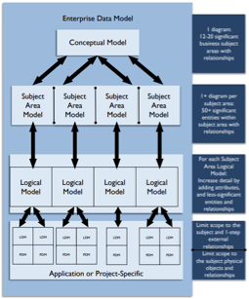
Dxtera DM Solutions
Data Connectors
Data Hub/Warehouse
Enterprise Data Model
Banner
PeopleSoft
EagleApps
Etc.
SIS
Data Hub
D2L
Canvas
Blackboard
Etc.
LMS
Composed Of
PeopleSoft
Salesforce
Etc.
HR
Data Warehouse
Many operational domains have been modelled
Other..
Notes:
SCOTT: DXtera’s solution is based around:
A collection of data connectors to integrate with a wide-variety of educational systems
A centralized Data Hub to manage the data in accordance with a pre-defined model.
A road-tested, well-defined enterprise service and data model

Slide 34
The heart of the DXtera data solutions is a comprehensive enterprise data model for academics and education based on over 3 decades of work road-tested at multiple institutions. This solution allows business users to leverage standard tools to provide ready access to key business information. It also provides a means for analytic teams to rapidly iterate in the solution space while ensuring that the data that the analysis relies on is current, accurate, and consistent.
Notes:
SCOTT:
Wide data - review to add?

Slide 35
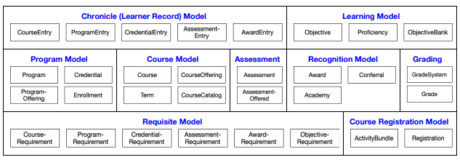
OSID DATA MODEL
Unified model for describing interactions with Academic and education data
Includes modules for Course/Program, Finance Data, Hr/Personnel and more.
Open source/openly available
Associated connectors and data stores read and write using this model as a base.
Extensible
Current Status
Who has access?
How can I get involved?
Built and used in multiple solutions including:
Data Hub/Data Warehouse
Service Hub
Point integration solutions (Credential Engine, Gardner, etc.)
EagleApps SIS uses a compatible Data Model
Open source and available at:
osid.org
Ongoing communication between the osid team and DXtera. Public documentation is available for review.
Notes:
AMON:

Slide 36
DATA CONNECTORS
Designed and built to the OSID specifications
Implemented to multiple technologies:
Managed in DXtera’s integration runtime environment, deployed in campus data-centers or in the cloud
Developer toolkit accelerates connector development
Current Status
Who has access?
How can I get involved?
Connectors developed and tested for core data entities in Banner SIS
Connectors developed and tested for DXtera Data Hub
Connectors being developed for PS Human Resource Management
Members have access to the open elements of the code base.
Open to pull requests
Multiple upcoming connector projects
Learning Management
Student Information
Finance
HR/Personnel
Notes:
AMON:

Slide 37
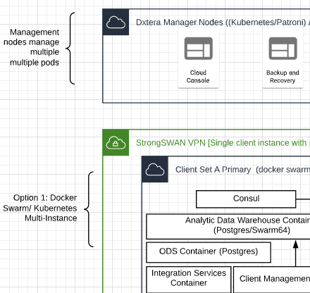
DATA HUB/
DATA WAREHOUSE
Unified data stores built on open-source technologies (Postgres)
Data Hub provides centralized data staging in a relational form
Data Warehouse provides an ever growing collection of reporting models
Built to connect with solutions that provide data using the OSID services
Scalable to multiple petabyte storage (via Greenplum or Postgres in the cloud via Citus)
DXtera plans to provide cloud data hub/warehouse services end of 2020/early 2021
Current Status
Who has access?
How can I get involved?
Onsite solution in a beta state.
In active development/refinement
Optimizing access and performance
Building out our Education Cloud Data Hub/Data Warehouse Solutions
Members have access to the open elements of the code base.
Select Members will have access to upcoming cloud beta
Open to pull requests.
Online discussion hub
DXtera DW Working Group
Monthly meetings
Proof of concept projects
Notes:
AMON:

Slide 38
Trend 2: Data Stewardship/ What is Good Data Practice?
“Instead, those with domain expertise across departments must rely on and compete for the time and resources of a limited pool of data engineers, scientists, and analysts.
It’s an inefficient system that only grows more complex as the volume and scope of data continue to increase.”
--Sigma Computing
from 2020 Data Trends and Predictions
Notes:
AMON:

Slide 39
Trend 2: Data Stewardship/ What is Good Data Practice?
Do you have institutional data policy, principles, and practices?
Is it written down and widely published?
Does every data set you have an associated data steward responsible for accuracy, access control, and helping users to understand the meaning/context of the data?
Notes:
SCOTT:

Slide 40
Trend 2: Data Stewardship/ What is Good Data Practice?
In addition, there are some common practices to keep in mind.
Don’t store data unless there is a plan to maintain it.
Don’t store data unless you know why.
Don’t collect data that already is being collected within the organization.
Don’t collect data until it’s needed.
Decide data retention policies before collecting data.
Review Data models before building a system.
Document the data definition and sensitivity before collection.
Only update data in its’ System of Record
Validate your data
Notes:
SCOTT: To combat data proliferation we have a number of key practices that we recommend. While this will not stop data proliferation, it will go a long way in identifying the purpose for any given data set.

Slide 41
Trend 2: Data Stewardship/ What is Good Data Practice?
DATA OWNERSHIP Business data created at or obtained within the organization belong to the organization, not to any particular function, unit, or individual.
DATA PRIVACY Members of the organization’s community are responsible for ensuring that their uses of the business data of the organization are consistent with the organization’s policy on privacy of information.
DATA STEWARDSHIP It is the responsibility of the designated data steward of a particular data collection to ensure data integrity, security, and accessibility to all who demonstrate need.
INFORMATION CONSISTENCY Administrative applications should facilitate information consistency across departments and not meet only the needs of the user-sponsor.
TIMELINESS/ACCURACY Administrative applications should ensure that business information is available when needed to affect decisions.
ELECTRONIC DATA TRANSFER Administrative applications should transfer data electronically from the point of origin and to the ultimate end user.
Notes:
SCOTT: Here is an example of a set of data principles. Principles can vary according to the institution, but their are critical for guiding your data efforts.

Slide 42
Trend 2: Data Stewardship/ What is Good Data Practice?
The costs of poor data management are significant:
Don’t know what business questions you can answer accurately.
Lack of awareness of what data is captured and its relative sensitivity
Lack of understanding the impact of a data breach.
Lack of a common usage and understanding of their data
Poor Data Stewardship can result in - Lack of responsibility/accountability
Who can you ask questions about the data
Who corrects issues?
Where are the issues corrected?
Who decides what the access should be and who should have it?
Notes:
SCOTT: The costs of poor data stewardship are significant…
Sadly this work cannot be automated, at least not in the first pass. In order for data to be useful across multiple users (as opposed to for a single set of siloed analyses), data management requires building a common language and common models around the data.

Slide 43
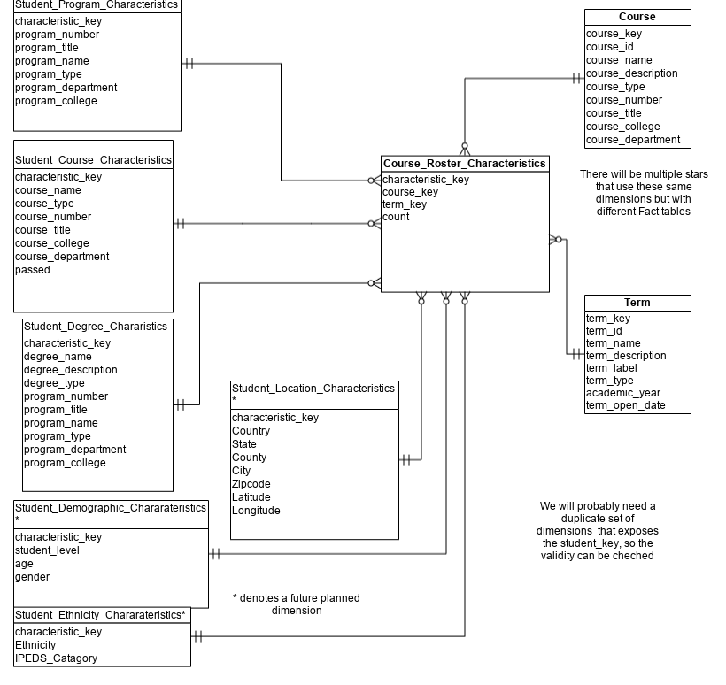
DATA WAREHOUSE MODELS
(Self-service Reporting)
Data Warehouse models are available to our membership.
Ongoing Data/Model Ops process to continually review and extend the model collection
Model reference instances built into the data warehouse solution.
Allows users to build their own reports from streamlined data structures.
Current Status
Who has access
How can I get involved?
Existing Data Models available in documentation and deployed at multiple sites
In active development
Completing onsite deployment
Cloud Solution upcoming
Quarterly model update cycle
Part of the warehouse deployment package (for members who are deploying/accessing the warehouse).
Documentation available online and available to the Data Warehouse Community members
Join the Data Management Warehouse community.
Contact us about deployment
Get involved in working group session.
Notes:
AMON:

Slide 44
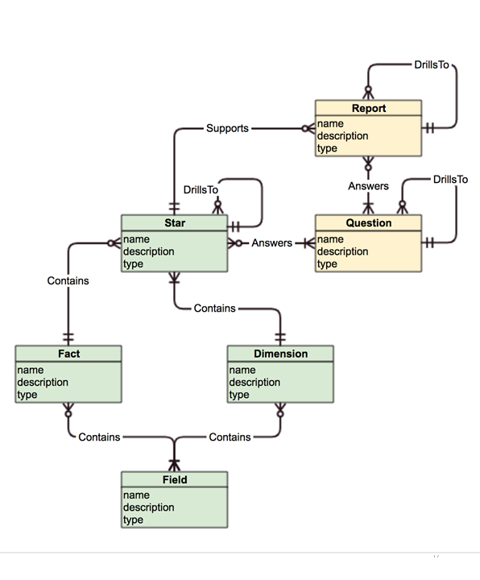
DATA GOVERNANCE/
DATA METADATA MANAGEMENT
Unified data governance tool set provides data dictionary, lineage and data cataloging.
Built to provide end-users with a path to query business questions and find the data sources (reports, dashboards, notifications) that they can use to access the answer
Includes user-extensions to add institutional knowledge
Part of the ongoing data management practice
Current Status
Who has Access
How can I get involved
Reference UI instance part of the Data Warehouse offering.
Backend integrated with the data solutions.
Allows user annotations of data
Links Business questions to data sources
Part of the warehouse deployment package (for members who are deploying/accessing the warehouse).
Join the Data Management/Data Governance community.
Contact us about deployment
Get involved in working group session
Notes:
AMON:

Slide 45
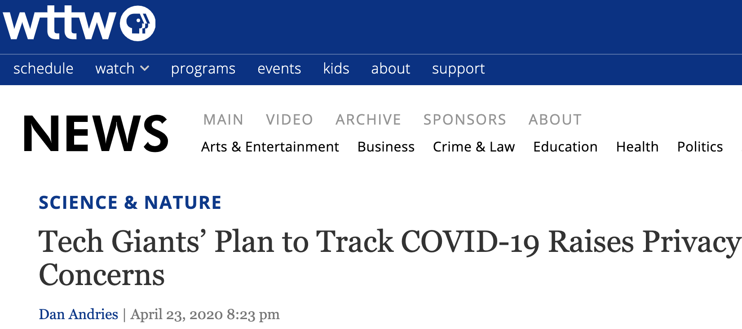
Trend 3: Responsible Use of Institutional Data
Suddenly, responsible data sharing matters to everyone
Notes:
MATT

Slide 46
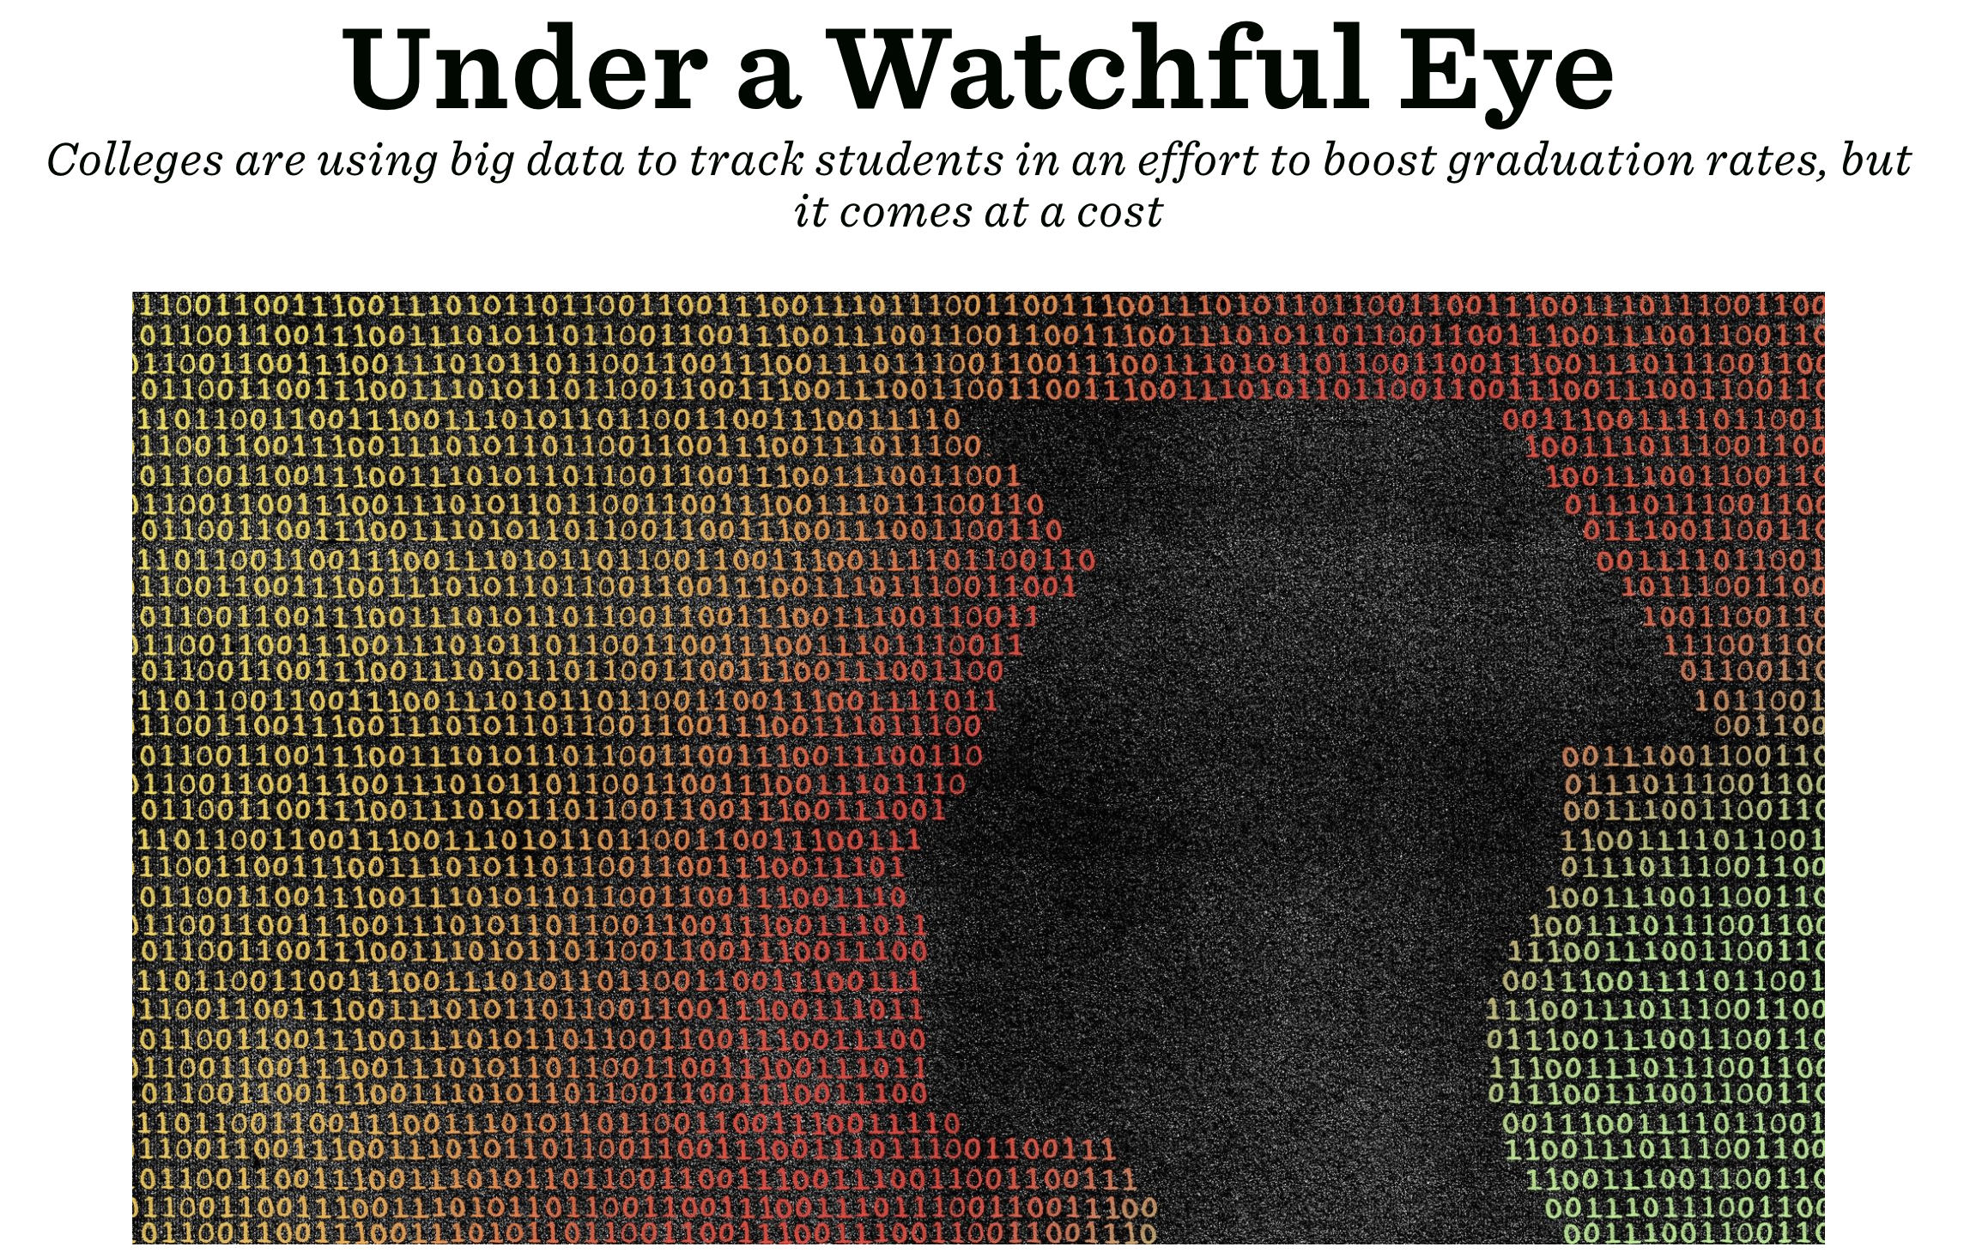
Notes:
MATT

Slide 47
Regulations are out of sync with today’s complex digital landscape
“Yet colleges and universities inherit a long-standing obligation to hold student credentials information securely and into perpetuity. When the information is covered under government statute, this obligation has the force of law. Additionally, academic research increasingly requires shared access to data to enable verification or disconfirmation of findings for scientific progress. At present, the domains of edtech and learning analytics are without commonly shared routines for adjudicating conflicts of interest in data use for academic, commercial, and scientific purposes.“
-- Martin Kurzweil and Mitchell Stevens
(Setting the Table: Responsible Use of Data in Higher Education - 2018)
Notes:
MATT: Responsible data usage content goes here

Slide 48
Regulations are out of sync with today’s complex digital landscape

Slide 49
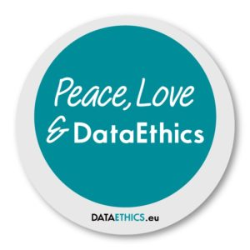
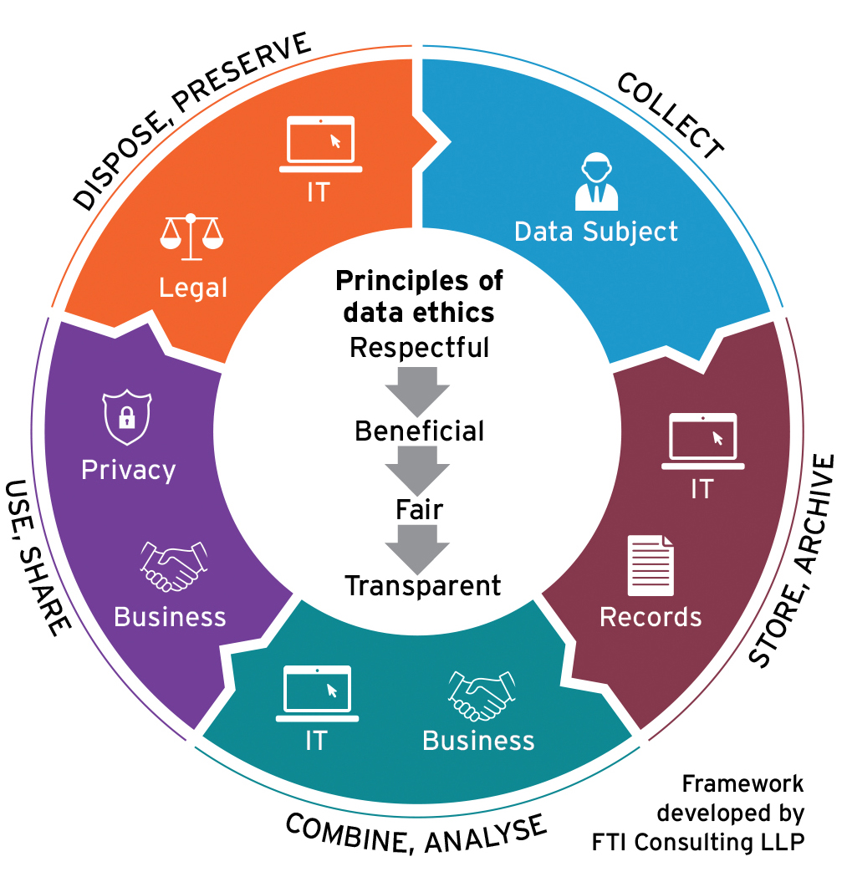
Rapidly Renegotiating our Societal Contract Around Data
Notes:
MATT

Slide 50
Issues & Innovations in responsible data use pressure tested by COVID-19
Beyond compliance: baking in data ethics
People are more important than tech: investing in emerging data roles
Equity as a data integration issue
Quantifying and weighing costs and benefits of data use
Data reuse vs misuse vs missed use
Juggling tradeoffs in protocols
Flash-in-the-pan tech-only responses vs. long-term solutions, redesign, and modernization
Rethinking consent
Rethinking identity
Rethinking trust
Rethinking student control, participation and inclusive governance
Notes:
vs. Data misuse - legally obtained, then later used for purposes outside the scope of legitimate reasons for the initial data collection (e.g., surveillance or advertising)
- enter it once, use it downstream multiple ways

Slide 51
Trend 3: Responsible Use of Institutional Data
Recommendations for responsible data usage:
Have express data usage policies (don’t share spreadsheets).
Data access and usage policies are documented.
Student data is primarily for the use of the institution in achieving its educational goals.
Data should not shared with third-parties unless it expressly supports the above and you have an express data usage policy with the third-party.
Hosted data solutions require legal contracts with the third-party
Express data retention and separation rules with third-parties.
Notes:
MARY:

Slide 52
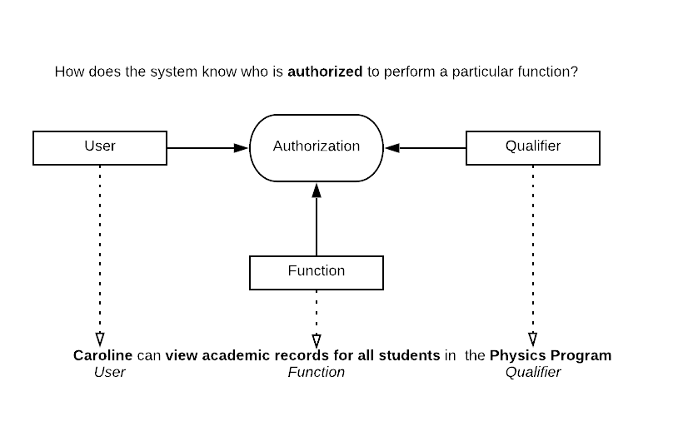
AUTHORIZATION MANAGEMENT
Business oriented authorizations designed to capture your business decisions about access.
Constructed as english language sentences.
Tools for managing access to DXtera solutions
Can import authorizations from external sources
Can also be used as primary tools for authorizations
Current Status
Who has access
How can I get involved
Reference implementation front-end is available as part of the Data Hub/Data Warehouse context.
Upcoming UI enhancements and re-design.
Extending Authorizations to other tools in the Dxtera catalog
Part of the warehouse admin deployment package (for members who are deploying/accessing the warehouse).
Documentation available online and available to the Data Warehouse Community members
Join the DW community.
Contact us about deployment
Get involved in the Authorizations POC.
Notes:
AMON:

Slide 53
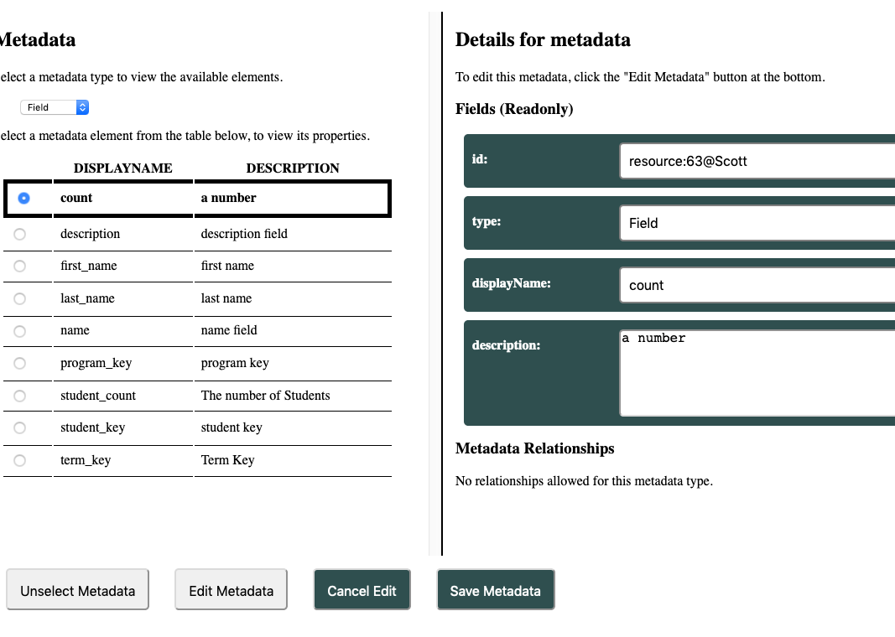
METADATA MANAGEMENT/ BUSINESS RULES TOOL
Allows end user groups to annotate their data.
Allows linking from the field level up to dashboards and reports.
Allows admin users to define business questions and match the answers to particular artifact
Upcoming functionality provides the means to build business rules from the metadata and drive notifications/exception reporting
Current Status
Who has access
How can I get involved
Backend integrated with the data solutions.
Draft architecture for business rules defined.
Initial rules base for providing notifications in place.
Build in process
Join the Data Management/ Metadata community
Join the Business Rules POC
Notes:
AMON:

Slide 54
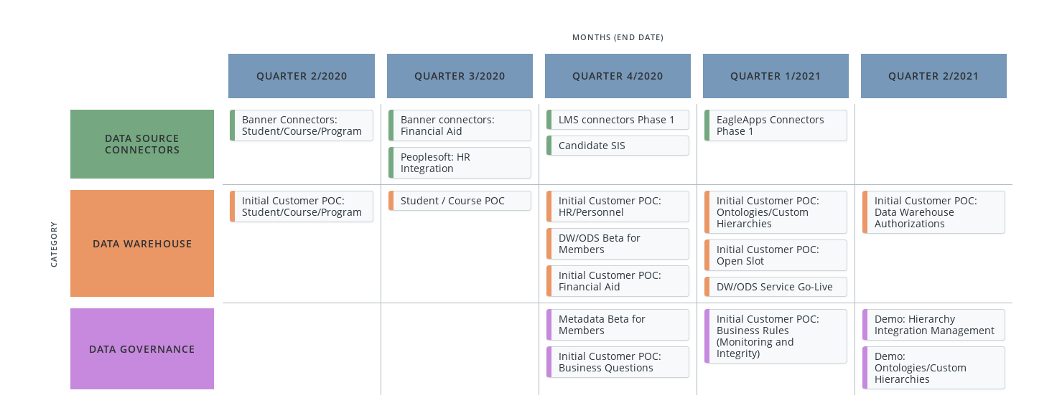
Dxtera DM Roadmap
Notes:
AMON:

Slide 55
How you can get involved?
Notes:
AMON:

Slide 56
DM Initiatives: Data Connectors
Q3/2020 | Peoplesoft HR Integration
Q4/2020 | LMS Connectors Phase 1
Q4/2020 | Next SIS Integration (ex. Jenzabar, Peoplesoft, Workday)
Q1/2021 | EagleApps Connectors
Notes:
AMON:
EagleApps Adapter
Next SIS
LMS

Slide 57
DM Initiatives: Data Warehouse
Q2/2020 | Initial Student/Course/Program Client Proof-of-Concept
Q4/2020 | Financial Aid Client Proof-of-Concept
Q4/2020 | HR/Personnel Client Proof-of-Concept
Q4/2020 | Cloud Data Hub/Data Warehouse Member BETA
Q1/2021 | Ontologies/Custom Hierarchies Client Proof-of-Concept
Q1/2021 | Open Slot Customer POC
Q2/2021 | Data Warehouse Authorizations POC
Notes:
AMON:

Slide 58
DM Initiatives: Data Governance
Q3//2020 | Business Questions Proof of Concept
Q4/2020 | Metadata Management Tool Beta
Q4/2020 | Business Rules (Automated monitoring and integrity checking) - Proof of Concept
Notes:
AMON:

Slide 59
Questions and Answers

Slide 60
Next Steps
To request additional information please send an email to: data@dxtera.org
Please let us know what our focus should be for the next set of presentations:
Quarterly Roadmap Update in December
Weekly “Office Hours” sessions for DXtera members starting in September
Also please visit http://dxtera.org for more information
Notes:
JEFF:

Slide 61
Thank you!

